Slide 1
EXPLORATORY ANALYSIS ON Amazon product sales
DATA
DATA
Here is the presentation begins
Presented by Sandeep Chopra

Slide 2
TABLE OF CONTENT
AMAZON PRODUCT SALES Data ANALYSIS
Introduction
Statistics and Sample Response
Data Understanding
Data Exploration and visualization
Flow chart of Exploratory Data Analysis
Graphs
Insights From Data
Summary and Future Takeaways

Slide 3
INTRODUCTION
AMAZON PRODUCT SALES Data ANALYSIS
Amazon is one of the largest e-commerce companies in the world, with billions of products sold each year. By analyzing Amazon product sales data, we can gain valuable insights into the customer journey, product trends, and market competition

Slide 4

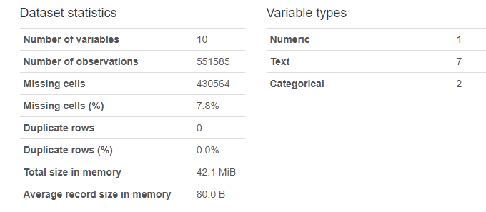
STATISTICS SAMPLE response
AMAZON PRODUCT SALES Data ANALYSIS
&

Slide 5
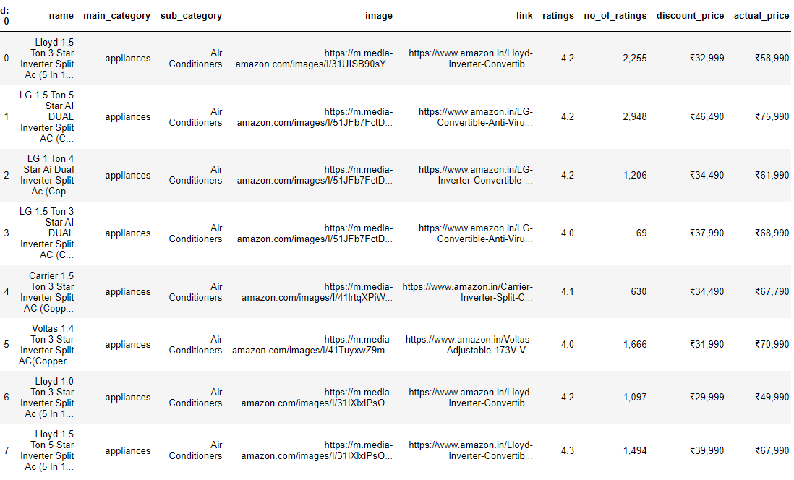
SAMPLE response
AMAZON PRODUCT SALES Data ANALYSIS

Slide 6
WHOA!
AMAZON PRODUCT SALES Data ANALYSIS
This can be the part of the presentation where we introduce the visualizations…

Slide 7
Data EXploration
AMAZON PRODUCT SALES Data ANALYSIS
Data collection
01
02
Data cleaning
Obtain the dataset from
Kaggle
Handling Missing values
Remove Duplicates
DATA TRANSFORMATION
04
03
Descriptive statistics
Convert Data types
Feature Scaling
Feature Engineering
Mean
Mode
Median
Standard Deviation
05
06
Hypothesis testing
visualization
Create Visual Representations
Test assumptions or relationships in the data using statistical methods to validate or reject hypotheses.

Slide 8

Data Visualization
AMAZON PRODUCT SALES Data ANALYSIS
IS WORTH A THOUSAND WORDS
A PICTURE

Slide 9
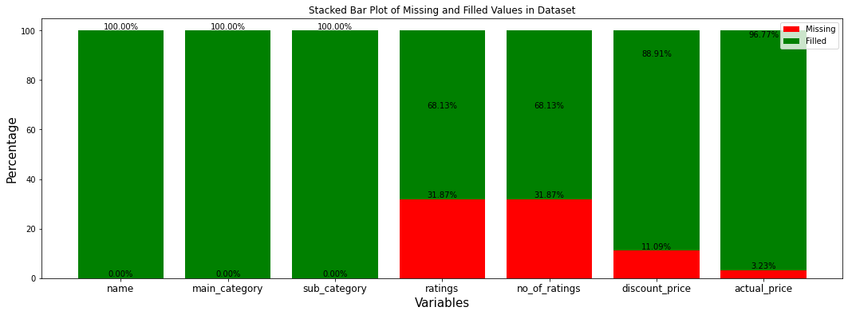
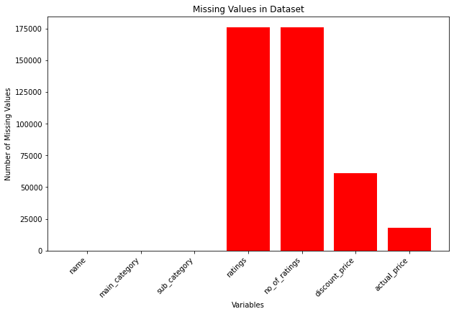
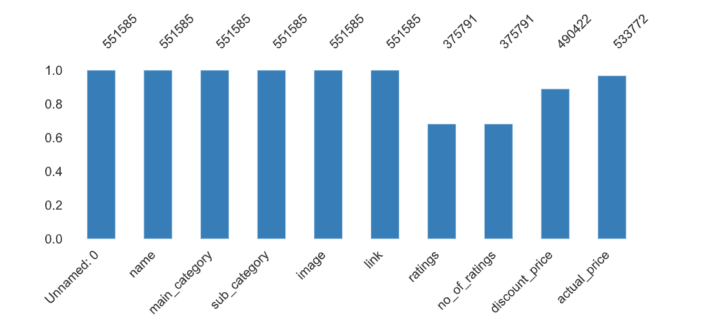
Missing values
AMAZON PRODUCT SALES Data ANALYSIS

Slide 10
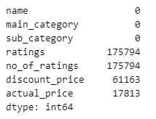
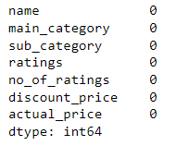
Handling Missing values
AMAZON PRODUCT SALES Data ANALYSIS
Remove rows or columns with greater than 70% missing values, if necessary.(if it is a crucial pillar of analysis try different approach)
Fill null values with 0, the mean, median, mode, or other appropriate methods.(In my project, I filled with median)

Slide 11
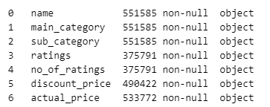
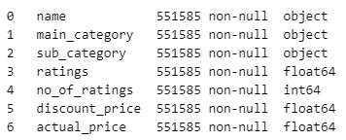
Data transformation
AMAZON PRODUCT SALES Data ANALYSIS
Converting Data Types
Convert data types to ensure that each column has the correct data type.

Slide 12
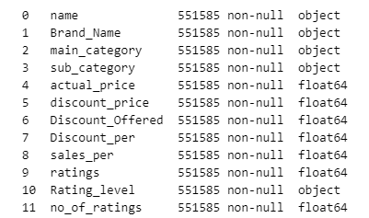
AMAZON PRODUCT SALES Data ANALYSIS
Create new features that may be more informative for the analysis or modelling.
Adding extra columns like discount percentage, sales percentage, rating level
for better insight

Slide 13
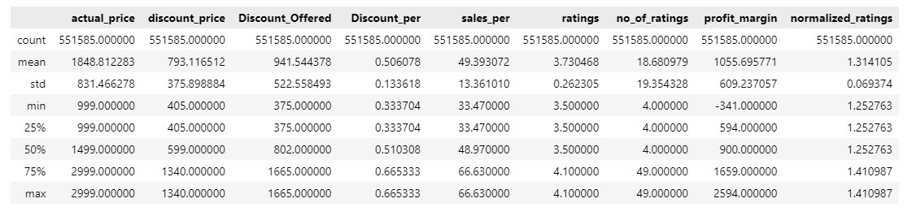
Descriptive statistics
AMAZON PRODUCT SALES Data ANALYSIS

Slide 14
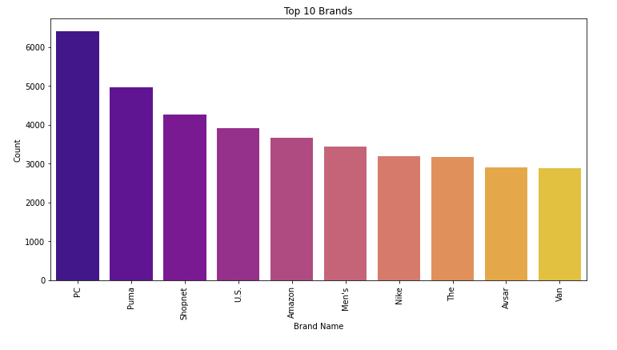
VISUALIZATION
AMAZON PRODUCT SALES Data ANALYSIS
What are the top 10 brands with respective to their product counts?

Slide 15
AMAZON PRODUCT SALES Data ANALYSIS
What is the most selling product with respective to their product counts?
“ The most selling products are from PC brand. ”

Slide 16
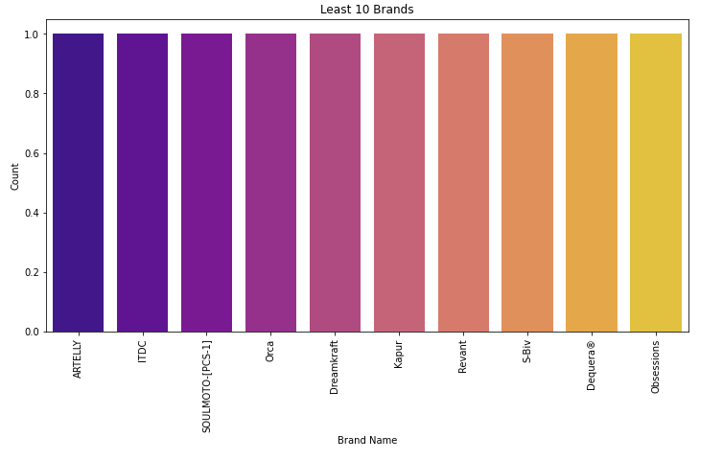
VISUALIZATION
AMAZON PRODUCT SALES Data ANALYSIS
What are the bottom 10 brands with respective to their product counts?

Slide 17
AMAZON PRODUCT SALES Data ANALYSIS
What are the bottom 10 brands with respective to their Product counts?
“ The least selling products are from 'ARTELLY', 'ITDC', 'SOULMOTO-[PCS-1]', 'Orca', 'Dreamkraft', 'Kapur', 'Revant', 'S-Biv', 'Dequera®', 'Obsessions' brands. ”

Slide 18
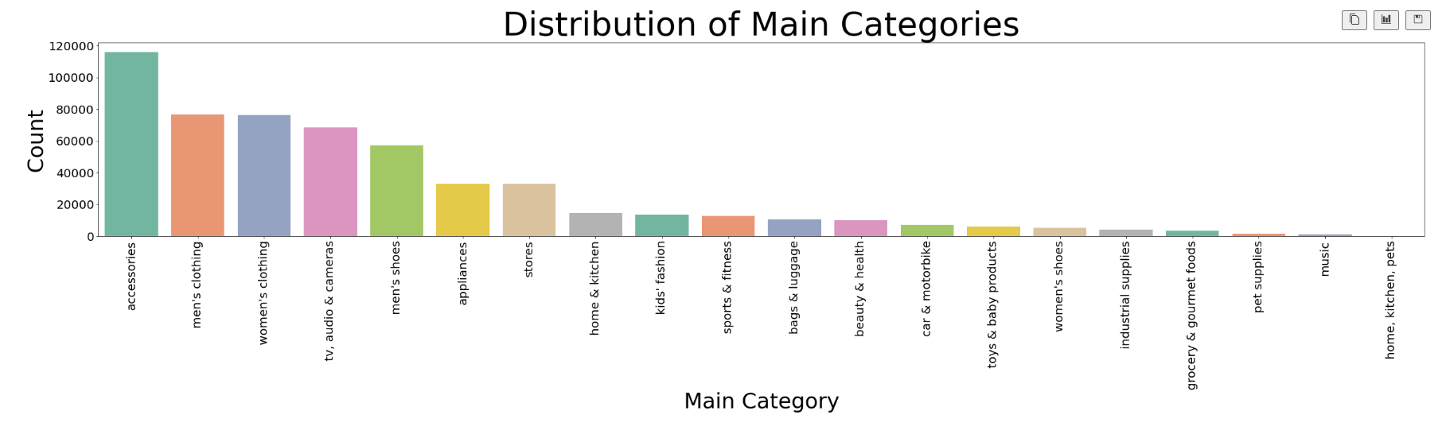
VISUALIZATION
AMAZON PRODUCT SALES Data ANALYSIS
What are the main categories of the products in terms of their counts?

Slide 19
AMAZON PRODUCT SALES Data ANALYSIS
What is the best main categories of the products in terms of their counts?
“The most selling main category is Accessories.”

Slide 20
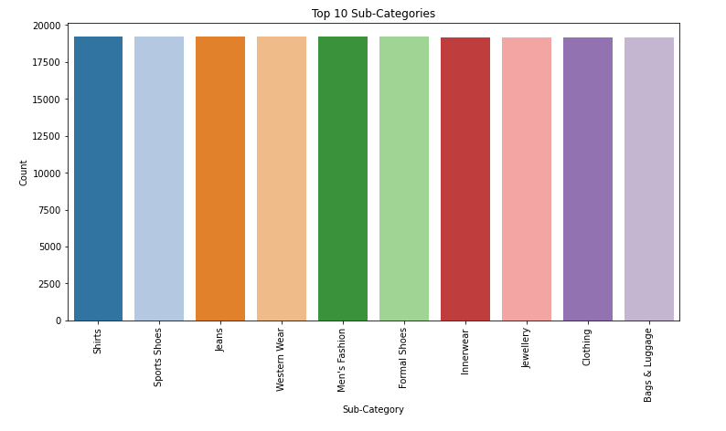
VISUALIZATION
AMAZON PRODUCT SALES Data ANALYSIS
What are the top 10 sub categories with respect to product count?

Slide 21
AMAZON PRODUCT SALES Data ANALYSIS
What are the top 10 sub categories with respect to product count?
“ 'Shirts', 'Sports Shoes', 'Jeans', 'Western Wear', "Men's Fashion", 'Formal Shoes', 'Innerwear', 'Jewellery', 'Clothing’, 'Bags & Luggage’ . are the top 10 sub categories. ”

Slide 22
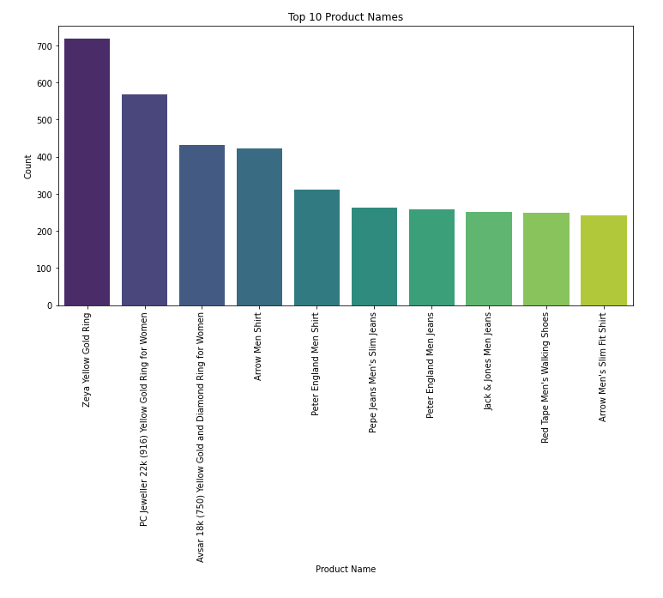
VISUALIZATION
Data ANALYSIS
Which products are the most popular on Amazon?

Slide 23
Data ANALYSIS
Which products are the most popular on Amazon?
“ 'Zeya Yellow Gold Ring' is
most popular on amazon. ”

Slide 24
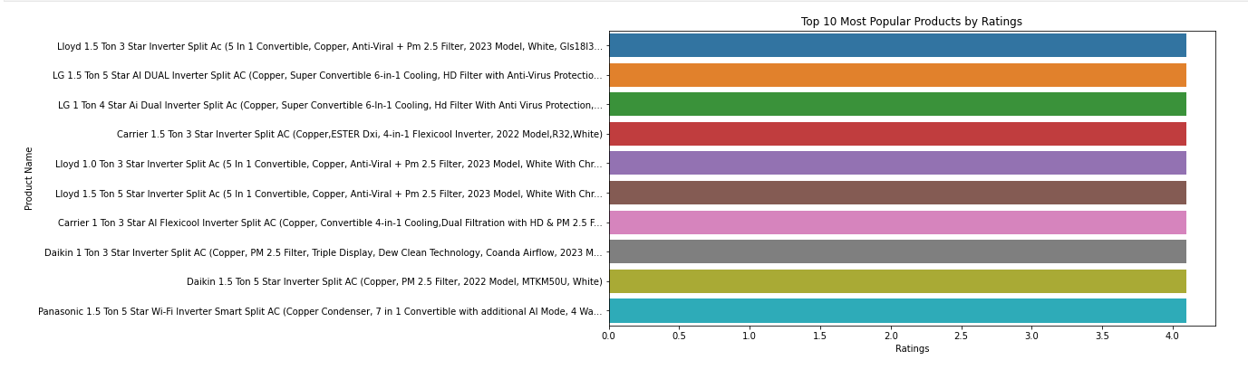
VISUALIZATION
Data ANALYSIS
What are the top 10 most popular products by ratings?

Slide 25
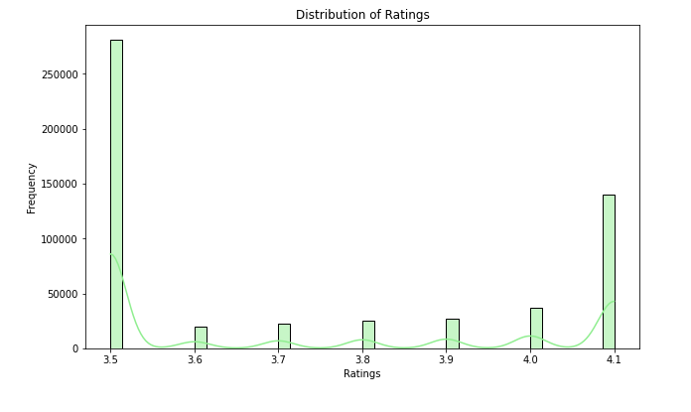
VISUALIZATION
Data ANALYSIS
What is the distribution of the ratings for the products in the dataset, and what insights can we gain from this distribution?

Slide 26
Data ANALYSIS
What is the distribution of the ratings for the products in the dataset, and what insights can we gain from this distribution?
“we can conclude that we have more number of ratings as 3.5. ”

Slide 27
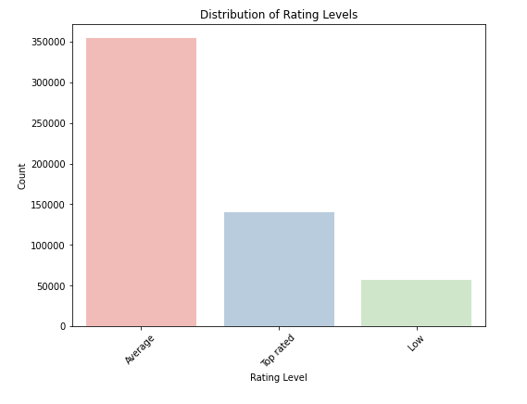
VISUALIZATION
Data ANALYSIS
What is the distribution of ratings given to the products in the dataset, and what can we infer from this rating distribution?

Slide 28
Data ANALYSIS
What is the distribution of ratings given to the products in the dataset, and what can we infer from this rating distribution?
“ we can conclude that Average rating products are high. ”

Slide 29
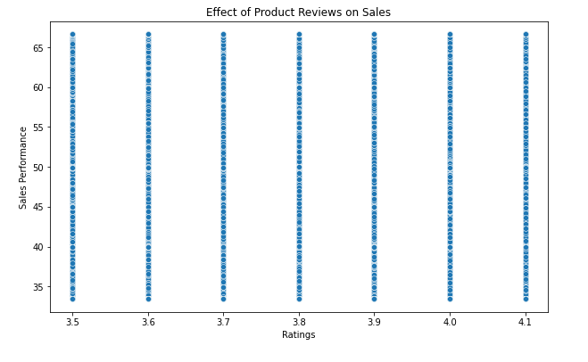
VISUALIZATION
Data ANALYSIS
Explain the relationship between ratings and sales performance?

Slide 30
Data ANALYSIS
Explain the relationship between ratings and sales performance?
“A significant concentration of products falls within the rating range of 3.5 to 4.1, and this concentration is represented by a dense cluster of data points in the scatter plot. ”

Slide 31
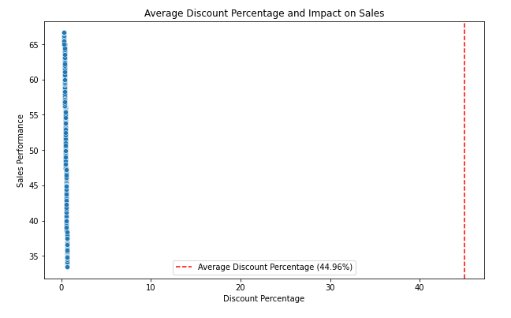
VISUALIZATION
Data ANALYSIS
Explain the relationship between discount percentage and sales_performace?

Slide 32
Data ANALYSIS
Explain the relationship between ratings and sales performance?
“A. The average discount percentage is 44.96%, indicating heavy reliance on discounts by retailers to boost sales.”

Slide 33
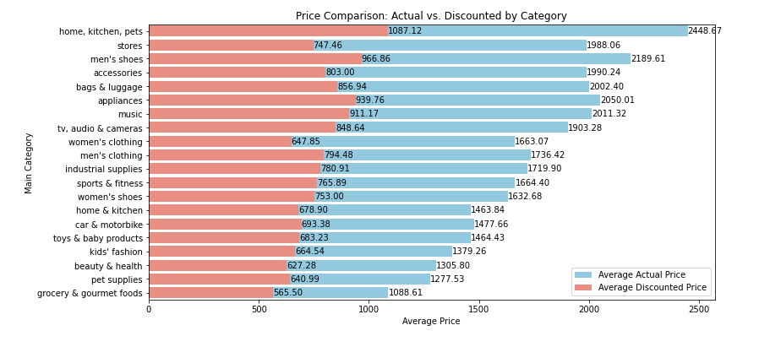
VISUALIZATION
Data ANALYSIS
Explain how actual prices compare to discounted prices by category?

Slide 34
Data ANALYSIS
Explain how actual prices compare to discounted prices by category?
“High discount in Home, Kitchen, pets and low discount in grocery & gourmets foods.”

Slide 35
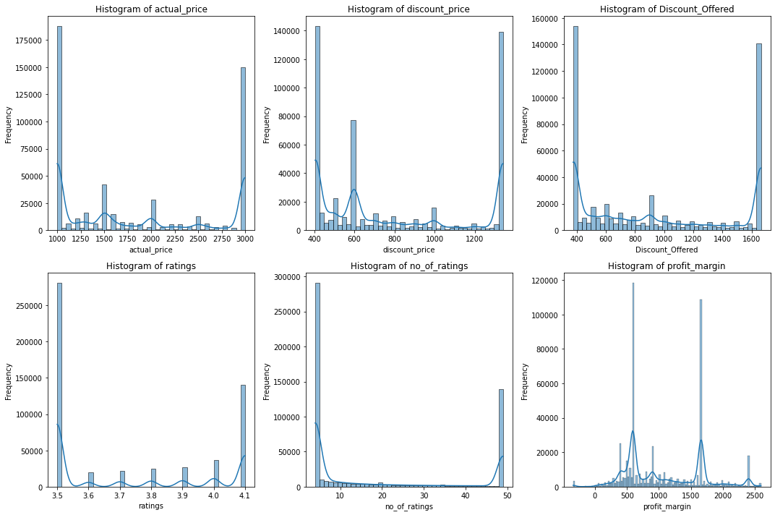
Distribution
Data ANALYSIS
None of the columns are
normally distributed

Slide 36
Insights from analysis
Data ANALYSIS
Category Dynamics:
Varied ratings across categories indicate diverse consumer perceptions and preferences.
Consumer Preferences:
Ratings between 3.0 and 4.6 significantly influence sales, showcasing customer-driven market trends.
Market Popularity and Competition:
Category competitiveness reflects diverse market landscapes and varying consumer demands.
Sales Performance and Category Trends:
Varied category sales performances highlight differing consumer interests and preferences.
Pricing and Discounts:
Heavy discount reliance in certain categories implies a strategic sales-boosting approach.
Rating and Sales Correlation:
Strong correlations between higher ratings and better sales emphasize customer feedback impact on purchases.

Slide 37
Summary
Data ANALYSIS
Analyzing Amazon's diverse category dynamics, consumer preferences, sales trends, pricing strategies, and the correlation between ratings and sales offers deep insights into the evolving e-commerce landscape
Future takeaways
Tailoring marketing strategies based on insights into consumer preferences and the impact of ratings on sales performance.
Refining pricing strategies based on the observed heavy reliance on discounts in specific categories while ensuring profitability.
Implementing predictive models to foresee future market trends and anticipate consumer behavior changes for strategic planning.

Slide 38
THANKS!
Data ANALYSIS
Do you have any questions?
sandeepchopra1209@gmail.com

